Slide 1
COMP 4290
Week 11 - Friday

Slide 2
Collect Passwords and Secret Phrases

Slide 3
Last time
What did we talk about last time?
Started privacy

Slide 4
Questions?

Slide 5
Project 3

Slide 6
Assignment 4

Slide 7
Olivia Crespo Presents

Slide 8
Review

Slide 9
Program Security

Slide 10
Buffer overflow
A buffer overflow happens when data is written past the end (or beginning) of an array
It could overwrite:
User data
User code
System data
System code
User Data
 |  |  |  |  | A | A | A | A | A | A | A | A | A | A | B
User Data
User Code
 |  |  |  |  | A | A | A | A | A | A | A | A | A | A | B
User Data
System Data
 |  |  |  |  | A | A | A | A | A | A | A | A | A | A | B
User Data
System Code
 |  |  |  |  | A | A | A | A | A | A | A | A | A | A | B

Slide 11
Incomplete mediation
Incomplete mediation happens with a system does not have complete control over the data that it processes
Example URL:
http://www.security.com/query.php?date=2012March20
Wrong URL:
http://www.security.com/query.php?date=2000Hyenas
The HTML generates the URL, but the URL can be entered manually

Slide 12
Time-of-check to time-to-use
A time-of-check to time-to-use flaw is one where one action is requested, but before it can be performed, the data related to the action is changed
The book's example is a man who promises to buy a painting for $100 who puts five $20 bills on the counter and pulls one back when the clerk is turning to wrap up the painting
In this flaw, the first action is authorized, but the second may not be

Slide 13
Viruses
Terminology is inconsistent
Popular culture tends to call everything a virus
Sometimes we will too, but here are some other terms:
Almost all of these are, by definition, Trojan horses
Worms differ from viruses primarily because they spread across networks
Type | Characteristics
Virus | Attaches itself to a program and propagates copies of itself to other programs
Trojan horse | Contains unexpected, additional functionality
Logic bomb | Triggers action when condition occurs
Time bomb | Triggers action when specified time occurs
Trapdoor | Allows unauthorized access to functionality
Worm | Propagates copies of itself through a network
Rabbit | Replicates itself without limit to exhaust resources

Slide 14
Where Viruses Live
One-time execution
Boot sector
The part of a hard drive that says what code to load to start your OS
Memory resident
Sometimes called TSR (terminate and stay resident)
Inside documents
A few other places that are sensible:
Applications
Libraries
Compilers (infect programs as you create them)
Antivirus software

Slide 15
Virus Signatures
Storage patterns
The size of a file
Compare against a hash digest for the program
Execution patterns
Viruses are also suspicious because of the way they execute
The functioning of the code compared to some standard
Suspicious execution patterns (weird JUMP commands)

Slide 16
Polymorphic viruses
Because virus scanners try to match strings in machine code, virus writers design polymorphic viruses that change their appearances
No-ops, code that doesn't have an impact on execution, can be used for simple disguises
Clever viruses can break themselves apart and hide different parts in randomly chosen parts of code
Similar to code obfuscation
Advanced polymorphic viruses called encrypting viruses encrypt parts of themselves with randomly chosen keys
A scanner would have to know to decrypt the virus to detect it
Virus scanners cannot catch everything

Slide 17
Targeted malicious code
Trapdoors
A way to access functionality that is not documented
Often inserted during development for testing purposes
Salami attacks
Steal tiny amounts of money when a cent is rounded in financial transactions
Or, steal a few cents from millions of people
Rootkits
Privilege escalation
Keystroke logging

Slide 18
Testing to prevent programming flaws
Unit testing tests each component separately in a controlled environment
Integration testing verifies that the individual components work when you put them together
Function and performance tests sees if a system performs according to specification
Acceptance testing give the customer a chance to test the product you have created
The final installation testing checks the product in its actual use environment

Slide 19
Testing methodologies
Regression testing is done when you fix a bug or add a feature
We have to make sure that everything that used to work still works after the change
Black-box testing uses input values to test for expected output values, ignoring internals of the system
White-box or clear box testing uses knowledge of the system to design tests that are likely to find bugs
You can only prove there are bugs. It is impossible to prove that there aren't bugs.

Slide 20
Secure design principles
Saltzer and Schroeder wrote an important paper in 1975 that gave 8 principles that should be used in the design of any security mechanisms
Least privilege
Fail-safe defaults
Economy of mechanism
Complete mediation
Open design
Separation of privilege
Least common mechanism
Psychological acceptability

Slide 21
Web Security – User Side

Slide 22
Browser security issues
Browsers are how most of the world interacts with the Internet
There are lots of problems when trying to maintain security:
Browsers often connect to more than just the URL listed in the address bar
Fetching a page automatically fetches lots of other data
If the browser is corrupted, you have no protection
Most browsers support plug-ins, which can be malicious or badly implemented
Browsers can access data on the user computer
The user does not know what data the browser is sending

Slide 23
Man-in-the-Browser
The browser controls all the interactions with the world wide web
If your browser has been compromised, it doesn't matter how good your encryption is
The browser sees all the data before it is encrypted
SilentBanker is an example of a plug-in that stole bank information
The banking websites still worked!

Slide 24
Page-in-the-middle
A page-in-the-middle attack is one in which you are redirected to a page that looks like the one you wanted
For example, a copy of your banking website
Such a page might be arrived at because of a phishing link or DNS cache poisoning
A browser-in-the-middle attack is worse, since your browser is compromised and no websites can be trusted

Slide 25
Program download substitution
A page could trick you into downloading a file that appears to be an application you want
In reality, it's a virus, Trojan horse, or other malware
How do you know what you're downloading?
Often, there's no way to be sure

Slide 26
User-in-the-middle
A user-in-the-middle attack tricks an unsuspecting user to do something only a human can do, like solve a CAPTCHA
Spam and porn companies often have the same owners
People get offers for free porn in their e-mail, provided that they fill out a CAPTCHA
This attack is not very damaging to the individual, but it wastes time and fills the world with more spam

Slide 27

Browser authentication issues
We've already talked about how people authenticate
One of the problems here is that computers are failing to authenticate
You're not sure that the site you're connecting to is really your bank
The problem is hard because computers authenticate based almost entirely on what they know
It's possible to eavesdrop on such information
Some banks let you to pick a picture and a caption
GOAT POLITICS

Slide 28
Authentication approaches
Web authentication can be done with approaches beyond or in addition to a password
Shared secret
Secret questions asked earlier
One-time password
Password provided by a SecurID
Out-of-band communication
Sending a PIN and a credit card in separate mailings
Texting a one-time password to a registered cell phone

Slide 29
Defaced web site
Website defacement is when an attacker changes the content of a legitimate website
Usually, this is done by exploiting a weakness in authentication of the people who are allowed to update content
These attacks can be pranks
They can be done to demonstrate that security is poor
Often to embarrass government websites
They can be done to show political disagreement with the website or the agency behind the website
The changes could be subtle enough that the change is not noticed for a while

Slide 30
Fake website
Websites are easy to fake
By their nature, the HTML, JavaScript, CSS, and images used to create a website are all publically available
It's even possible to link to current images on the real website
This attack is usually designed to trick users into entering private information into the malicious website

Slide 31
Protecting websites
Detecting that a change has occurred on a website can be difficult
One approach is to make a hash value of the website
Store the hash elsewhere, securely
Hash the contents of the website periodically to see if it still matches
This approach only works if the data doesn't constantly change
Digital signatures allows companies to sign code to verify that they did originate the code
Example: ActiveX controls
You shouldn't be running this kind of code anyway

Slide 32
Web bugs
Only a website you visit can leave a cookie or run JavaScript, right?
Sure, but how many sites do you visit?
Images that are linked to other websites (especially ads) count as visiting other websites
Visiting a single page could store cookies from every ad on the page (and more!)
Web bugs are images that are usually 1 x 1 pixels and clear
They make it impossible to know how many sites could be storing cookies

Slide 33
Clickjacking
Clickjacking is when you think you're clicking on one button, but you're really clicking on another
It could be that you're agreeing to download or install a program that you don't think you are
Called a drive-by download
It could be that you think you're entering data into a real website, but it's just a front for a malicious one
These attacks are possible because web pages can have transparent frames, allowing you to see something that you're not really interacting with

Slide 34
Obtaining user or website data
The inherently unsecure model used for web interactions has a number of weak points
Some ways that website data can be leaked include:
Cross-site scripting
SQL injection
Dot-dot-slash
Server-side includes

Slide 35
Fake e-mail
There is lots of fake e-mail out there
The book calls spam fake or misleading e-mail
Several kinds of spam are rising
Fake "Your message could not be delivered" messages
Fake social networking messages
Current events messages
Shipping notices

Slide 36
Why do people send spam?
Advertising black- or graymarket pharmaceuticals
Pump and dump – artificially inflating the price of a stock
General advertising
Malware in the e-mail or in links from the e-mail
Advertising sites (such as porn) that might be illegal
Cost is virtually nothing

Slide 37
Dealing with spam
Legal approaches
US CAN-SPAM act
Directive 2002/58/EC in Europe
It's hard to define what is and isn't spam
Most laws require an opt-out mechanism, but enforcement is hard
IP addresses are easy to spoof, but the next generation Internet might change that
Screening programs try to filter out spam (with both false positives and false negatives)
Some web hosting companies enforce volume limitations on how many e-mails can be sent per day
Paying postage per e-mail?

Slide 38
E-mail spoofing
SMTP is the protocol for sending e-mail
It's very straight-forward
The from field is easy to spoof
There are protocols with authentication built in, but regular SMTP is entrenched how
You can never trust header information in an e-mail

Slide 39
Phishing
Phishing is when an e-mail tries to trick someone into giving out private data or doing something else unsafe
Spear phishing is phishing that targets a specific individual
Details about that user's life or accounts might be included
Whaling is a term used for spear phishing of rich people or celebrities
They have more money
Many of their personal details could be public

Slide 40
OS Security

Slide 41
Separation
OS security is fundamentally based on separation
Physical separation: Different processes use different physical objects
Temporal separation: Processes with different security requirements are executed at different times
Logical separation: Programs cannot access data or resources outside of permitted areas
Cryptographic separation: Processes conceal their data so that it is unintelligible

Slide 42
Memory protection
Protecting memory is one of the most fundamental protections an OS can give
All data and operations for a program are in memory
Most I/O accesses are done by writing memory to various locations
Techniques for memory protection
Fence
Base/bounds registers
Tagged architectures
Segmentation
Paging

Slide 43
Storing access control information
Directory based approaches
Create a directory that lists all the objects a given user can access and their associated rights:
Problems:
Directories can become large
How is access revoked?
What if two files in different locations in the system have the same name?
Access control lists
List all the users that have rights for a specific object
Most objects only have a few legal users
Wild cards can make the situation easier
Access control matrices
Both directories and access control lists are equivalent
We can also imagine a matrix that holds all subjects and all objects
It is too inefficient for most systems to be implemented this way, but security researchers sometimes use this model for theoretical purposes

Slide 44
Access control matrix example
 | Objects
Subjects | file 1 | file 2 | process 1 | process 2
process 1 | read, write, own | read | read, write, execute, own | write
process 2 | append | read, own | read | read, write, execute, own

Slide 45
Bell-LaPadula overview
Confidentiality access control system
Military-style classifications
Uses a linear clearance hierarchy
All information is on a need-to-know basis
It uses clearance (or sensitivity) levels as well as project-specific compartments
Unclassified
Confidential
Secret
Top Secret
Restricted

Slide 46
Security clearances
Both subjects (users) and objects (files) have security clearances
Below are the clearances arranged in a hierarchy
Clearance Levels | Sample Subjects | Sample Objects
Top Secret (TS) | Tamara, Thomas | Personnel Files
Secret (S) | Sally, Samuel | E-mail Files
Confidential (C) | Claire, Clarence | Activity Log Files
Restricted (R) | Rachel, Riley | Telephone List Files
Unclassified (UC) | Ulaley, Ursula | Address of Headquarters

Slide 47
Adding compartments
We add compartments such as NUC = Non-Union Countries, EUR = Europe, and US = United States
The possible sets of compartments are:
∅
{NUC}
{EUR}
{US}
{NUC, EUR}
{NUC, US}
{EUR, US}
{NUC, EUR, US}
Put a clearance level with a compartment set and you get a security level
The literature does not always agree on terminology

Slide 48
Romaine lattice
The subset relationship induces a lattice
{NUC, EUR, US}
{NUC, EUR}
{NUC, US}
{EUR, US}
{NUC}
{EUR}
{US}
∅

Slide 49
Bell-La Padula properties
Let L be a security level and C be a category
We say that security level (L, C) dominates security level (L', C') if and only if L' ≤ L and C' ⊆ C
Simple security requires (L_{S}, C_{S}) to dominate (L_{O}, C_{O}) and S to have read access
Read down
*-property now requires (L_{O}, C_{O}) to dominate (L_{S}, C_{S}) and S to have write access
Write up

Slide 50
Chinese Wall model
The Chinese Wall model respects both confidentiality and integrity
It's very important in business situations where there are conflict of interest issues
Real systems, including British law, have policies similar to the Chinese Wall model
Most discussions around the Chinese Wall model are couched in business terms

Slide 51
COI Examples
Bank COI Class
Gasoline Company COI Class
Bank of America
a
Citibank
c
Shell Oil
s
Standard Oil
e
Bank of the West
b
Union '76
u
ARCO
n

Slide 52
Chinese Wall overview
We can imagine the Chinese Wall model as a policy controlling access in a database
The objects of the database are items of information relating to a company
A company dataset (CD) contains objects related to a single company
A conflict of interest (COI) class contains the datasets of companies in competition
Chinese Wall rules prevent people from reading and writing data from CDs in different COIs

Slide 53
Biba model
Integrity based access control system
Uses integrity levels, similar to the clearance levels of Bell-LaPadula
Precisely the dual of the Bell-LaPadula Model
That is, we can only read up and write down
Note that integrity levels are intended only to indicate integrity, not confidentiality
Actually a measure of accuracy or reliability

Slide 54
Mandatory and discretionary access control
Mandatory access control (MAC) means that the controls are enforced by rules in the system, not by user choices
Bell-La Padula is a perfect example of MAC
Discretionary access control (DAC) means that the user has control over who can access the objects he or she owns
Linux and Windows are largely DAC systems
Most real systems have elements of both

Slide 55
Network Security

Slide 56
Packet switched vs. circuit switched
The Internet is a packet switched system
Individual pieces of data (called packets) are sent on the network
Each packet knows where it is going
A collection of packets going from point A to point B might not all travel the same route
Phone lines are circuit switched
This means that a specific circuit is set up for a specific communication
Operators used to do this by hand
Now it is done automatically
Only one path for data

Slide 57
Network strength
If a single cut can case a network to go down, that network is vulnerable to a single point of failure
Most important networks like electrical systems have redundancy so that this doesn't happen to a whole city
Resilience or fault tolerance

Slide 58
Terminology
A computer network is at least two computers connected together
Often one is a server and the other is a client
A computer system in a network is called a node
The processor in a node is called a host
A connection between two hosts is a link

Slide 59
Network characteristics
Anonymity: We don't know who we're dealing with
Automation: Communication may be entirely between machines without human supervision
Distance: Communications are not significantly impacted by distance
Opaqueness: It is hard to tell how far away other users are and to be sure that someone claiming to be the same user as before is

Slide 60
Transmission media
Copper wire
Twisted pair is a pair of insulated copper wires
Coaxial cable has a single wire surrounded by an insulation jacket covered by a grounded braid of wire
Repeaters or amplifiers are needed periodically to prevent signal degradation
Optical fiber
Carries light instead of electricity
Higher bandwidth and less signal degradation than copper
Replacing aging copper lines
Wireless
Good for short distance
Uses radio signals
Microwave
Strong signals
Requires line of sight
Infrared
Similar to microwave but weaker signals
Satellites
Need geosynchronous orbits
Secure applications need smaller footprints than broadcasts

Slide 61
Layers
Protocols and standards define each layer
Not every layer is always used
Sometimes user errors are referred to as Layer 8 problems
Layer | Name | Activity | Example
7 | Application | User-level data | HTTP
6 | Presentation | Data appearance, some encryption | TLS
5 | Session | Sessions, sequencing, recovery | IPC and part of TCP
4 | Transport | Flow control, end-to-end error detection | TCP
3 | Network | Routing, blocking into packets | IP
2 | Data Link | Data delivery, packets into frames, transmission error recovery | Ethernet
1 | Physical | Physical communication, bit transmission | Electrons in copper

Slide 62
TCP/IP
The OSI model is conceptual
Most network communication uses TCP/IP
We can view TCP/IP as four layers:
Layer | Action | Responsibilities | Protocol
Application | Prepare messages | User interaction | HTTP, FTP, etc.
Transport | Convert messages to packets | Sequencing, reliability, error correction | TCP or UDP
Internet | Convert packets to datagrams | Flow control, routing | IP
Physical | Transmit datagrams as bits | Data communication

Slide 63
TCP/IP
Transmission Control Protocol (TCP)
Creates a reliable communication session
Wraps information into packets
Uses port numbers to connect processes to information streams
Internet Protocol (IP)
Allows for unreliable transport
Wraps packets into datagrams
Uses IP addresses for routing
User Datagram Protocol (UDP)
Alternative to TCP that is unreliable but has low overhead

Slide 64
Reconnaissance
A smart attacker learns everything he or she can about the system before attacking it
Useful methods for reconnaissance of a network include:
Port scans
Social engineering
Dumpster diving
OS and application fingerprinting
Background research

Slide 65
Eavesdropping and wiretapping
Eavesdropping means overhearing private information without much effort
Administrators need to periodically monitor network traffic
Wiretapping implies that more effort is being used to overhear information
Passive wiretapping is only listening to information
Active wiretapping means that you may adding or changing information in the stream

Slide 66
Wiretapping
If you are on the same LAN, you can use a packet sniffer to analyze packets
Inductance allows you to measure the signals inside of a wire without a direct physical connection
Wireless is broadcast
Easy to intercept, but can be protected by WPA or WPA2 encryption (and hardly at all by WEP)
Microwave is easy to intercept
Heavy multiplexing makes it hard to untangle individual signals
Satellites are similar (unsecure but heavily multiplexed)
Optical fiber is very difficult to tap
Cutting a single fiber means recalibrating the network
Repeaters and taps that connect the fiber are the best places to attack

Slide 67
Authentication issues
Passwords are often easy to guess
Because we're bad at picking passwords
Because the user may not have realized that the machine would be exposed to network attacks
Passwords are sent in the clear
Bad hashes can give information about the password
Sometimes buffer overflows can crash the authentication system
Sometimes authentication is not needed
.rhosts and .rlogin files in Unix
Guest accounts
Default passwords on routers and other devices that never get changed

Slide 68
Authentication attacks
Spoofing is when an attacker carries out one end of a networked exchange
A masquerade is spoofing where a host pretends to be another host
URL confusion: someone types hotmale.com (don't go there!) or gogle.com
Phishing is a form of masquerading
Session hijacking (or sidejacking) is carrying on a session started by someone else
Login is encrypted, the rest of the data often isn't
Firesheep allows you to log on to other people's Facebook and Twitter accounts in, say, the same coffeeshop
Man-in-the-middle attacks

Slide 69
Confidentiality threats
Misdelivery
Data can have bad addresses, occasionally because of computer error
Human error (e.g. James Hughes (student) instead of James Hughes (professor)) is more common)
Exposure of data can happen because of wiretapping or unsecure systems anywhere along the network
Traffic flow analysis
Data might be encrypted
Even so, it is very hard to hide where the data is going to and where it is coming from
Tor and other anonymization networks try to fix this

Slide 70
Integrity threats
Attackers can falsify some or all of a message, using attacks we've talked about
Parts of messages can be combined
Messages can be redirected or deleted
Old messages can also be replayed
Noise can degrade the signals
All modern network protocols have error correction built in
Malformed packets can crash systems
Protocols often have vulnerabilities

Slide 71
Denial of service
Networks are one of the best places to launch an attack on availability
In this setting, these are usually called denial of service (DoS) attacks
Transmission failure can happen because a line is cut or because there is too much noise
Flooding is a common technique
Ask for too many connections
Request too many of some other service
Distributed denial of service (DDoS) attacks are common (often using zombies or botnets) to make a more damaging and hard to trace attack

Slide 72
Denial of service attacks
TCP SYN floods
Exploit the three-way handshake
Echo-chargen
Chargen sets up a stream of packets for testing
Echo packets are supposed to be sent back to the sender
If you can trick a server into sending echo packets to itself, it will respond to its own packets forever
Ping of death
A ping packet requests a reply
If you can send more pings than a server can handle, it goes down
Only works if the attacker has more bandwidth than the victim (DDoS helps)
Smurf
A ping packet is broadcast to everyone, with the victim spoofed as the originator
All the hosts try to ping the victim
The real attacker is hidden
Teardrop
A teardrop attack uses badly formed IP datagrams
They claim to correspond to overlapping sequences of bytes in a packet
There's no way to put them back together and the system can crash

Slide 73
DNS attacks
The Domain Name System (DNS) uses Domain Name Servers (also DNS) to convert user readable URLs like google.com to IP addresses
Taking control of a server means that you get to say where google.com is
For efficiency, servers cache results from other servers if they didn't know the IP
DNS cache poisoning is when an attacker gives a good server a bad IP address

Slide 74
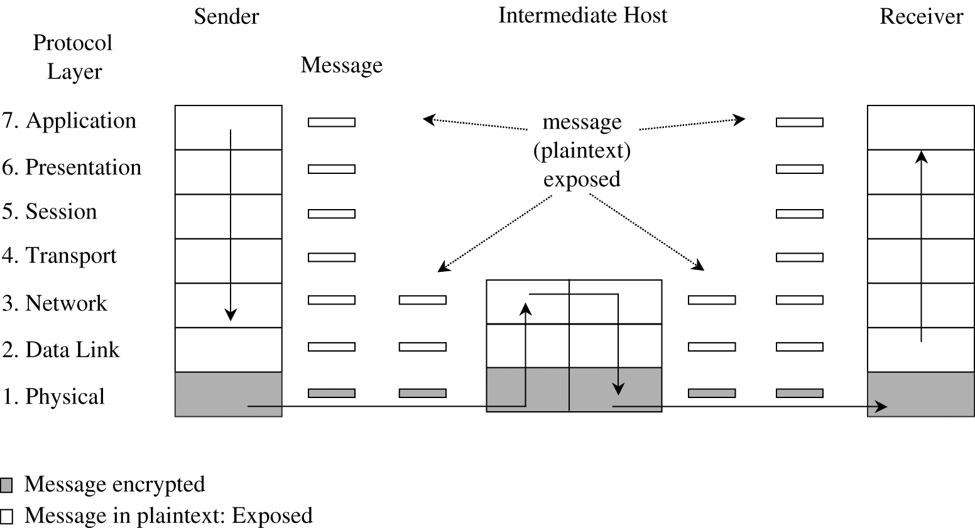
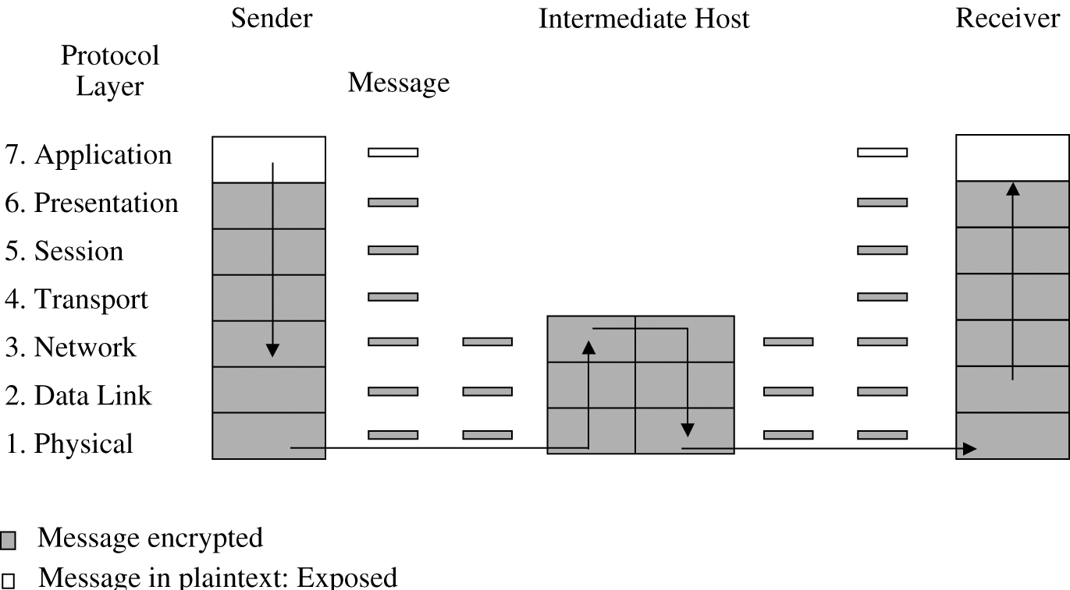
Network encryption
Encryption is important for network security
Link encryption encrypts data just before going through the physical communication layer
Each link between two hosts could have different encryption
Message are in plaintext within each host
Link encryption is fast and transparent
End-to-end encryption provides security from one end of the transmission to the other
Slower
Responsibility of the user
Better security for the message in transit

Slide 75
Database Security

Slide 76
What is a database?
A database is a collection of data and a set of rules to organize the data by relationships
A database administrator makes the rules and controls access
A database management system (DBMS) is the program through which the user interacts with the database

Slide 77
Database components
Almost all modern databases use the relational database model
The fundamental unit of organization is a table
An older format for databases was hierarchical, like a tree
A table consists of records
A record consists fields or elements, which are each a specific item of data

Slide 78
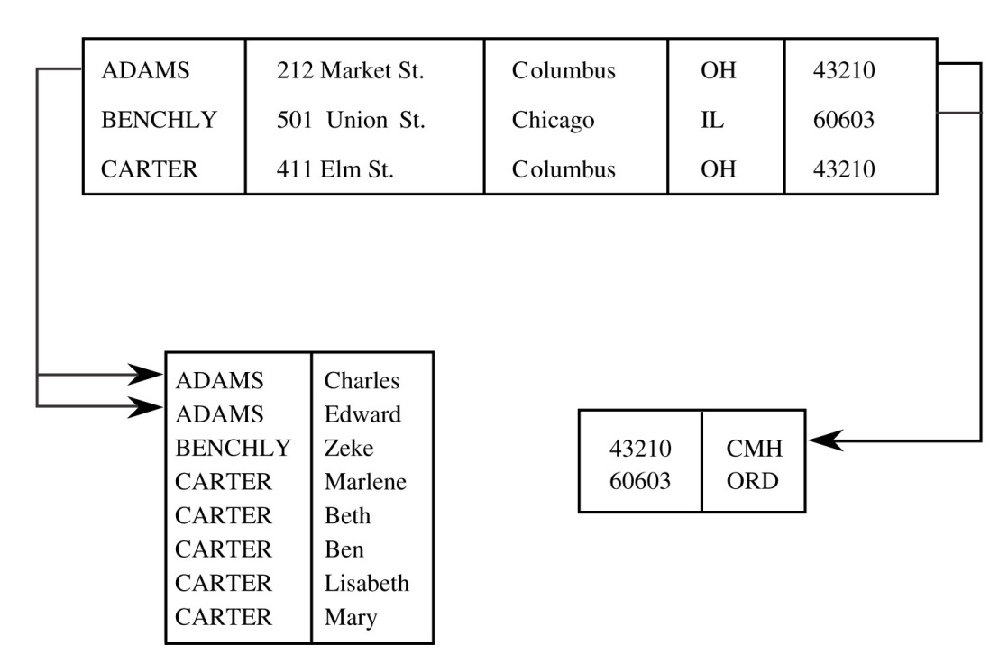
Schemas
The tables in a database are usually related to each other in some way
The logical structure of a database is called a schema
A user may only see part of it, called a subschema
An attribute is the name of a column
A relation is a set of columns

Slide 79
Queries
A query is the name of a command given to a database by a user
Queries can:
Retrieve
Modify
Add
Delete
Most databases allow commands to be issued through a variant of SQL

Slide 80
Database security requirements
Because they are a central part of modern business, several aspects of database security are crucial:
Physical database integrity
Logical database integrity
Element integrity
Access control
User authentication
Availability

Slide 81
Reliability and integrity
Reliability is a measure of how long a software system can run without failing
Reliability is often quoted in terms of uptime percentage
Or mean time between failures
Database reliability and integrity has three aspects:
Database integrity
Is the database as a whole protected from disk failure or corruption
Element integrity
Are only authorized users allowed to change elements
Element accuracy
Are the values in the elements correct

Slide 82
Two-phase update
A key problem for database integrity is what happens if the system fails in the middle of an update
Then the database is inconsistent
A two-phase update is a common solution
During the intent phase, the DBMS computes the results needed for the update, but does not change the database
During the commit phase, it changes all of the fields to the values computed in the intent phase
If the intent phase fails, the DBMS can start over from the beginning
If the commit phase fails, the DBMS can try to write all the data from the intent phase again

Slide 83
Disclosure of sensitive data
The most serious disclosure of sensitive data is its exact value
Bounds can also be disclosed
Example: highest salary and lowest salary
If the user can manipulate the bounds, he or she can search for specific values
Negative result
Felonies is not zero
Visits to the oncology ward is not zero
Existence
Knowing that a field even exists means someone is using it
Probable value
How many people are in Bob's dorm room? 2
How many people in Bob's dorm room pirate movies? 1
There's a 50% chance that Bob pirates movies

Slide 84
Direct attack
In a direct attack on sensitive information, a user will try to determine the values of a sensitive field by finding the right query
Sometimes an unusual query will be used to bypass checks

Slide 85
Indirect attack
To avoid leaking sensitive data, some DBMSs allow statistics to be reported
Each of the following statistics can be attacked in different ways:
Sum
Count
Mean
Median

Slide 86
Protecting against inference
Suppress obviously sensitive information
Easy, but incomplete
Track what the user knows
Expensive in terms of computation and storage requirements
Analysis may be difficult
Multiple users can conspire together
Disguise the data
Data is hidden
Users who are not trying to get sensitive data get slightly wrong answers

Slide 87
Integrity and confidentiality
Integrity is difficult, but we can assign levels of trust
It is necessarily not going to be as rigorous as Biba
Confidentiality
Difficult and causes redundancies since top secret information cannot be visible in any way to low clearance users
Worse, we don't want to leak any information by preventing a record from being added with a particular primary key (because there is a hidden record that already has that primary key)
Polyinstantiation means that records with similar or identical primary keys (but different data) can exist at different security levels

Slide 88
Upcoming

Slide 89
Next time…
Exam 2 is on Monday

Slide 90
Reminders
Exam 2 is Monday
Work on Project 3
Work on Assignment 4
Due next Friday

